Slide 1
§9.3: Representing Relations
Some ways to represent n-ary relations:
  With an explicit list or table of its tuples.
  With a function from the domain to {T,F}.
    Or with an algorithm for computing this function.
Some special ways to represent binary relations:
  With a zero-one matrix.
  With a directed graph.
*
School of Computer Science, BUPT
*

Slide 2
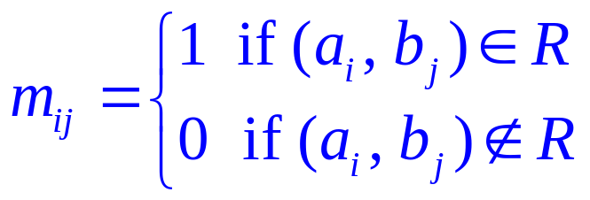
The Matrix of a Relation
Let A = {a₁, a₂, . . . , a_{m}} and B = {b₁, b₂, . . . , b_{n}}, R is a relation from A to B.
The m × n matrix M_{R} = [ m_{ij} ] defined by
M_{R} is called the connection matrix of R.
M_{R} provides an easy way to check whether R has a given property.
*
School of Computer Science, BUPT
*

Slide 3
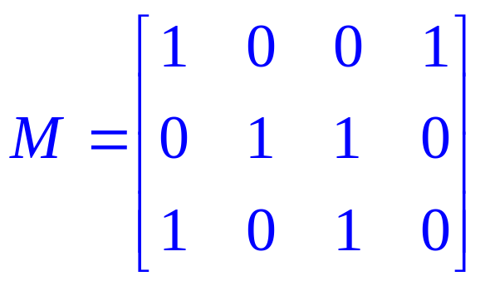
Example
Consider the matrix
Since M is 3 × 4, let
  A = {a₁, a₂, a₃} and B = {b₁, b₂, b₃, b₄}.
Then (a_{i}, b_{j}) ∈ R if and only if m_{ij} = 1.
  R = {(a₁, b₁), (a₁, b₄), (a₂, b₂), (a₂, b₃), (a₃, b₁), (a₃, b₃)}
*
School of Computer Science, BUPT
*

Slide 4
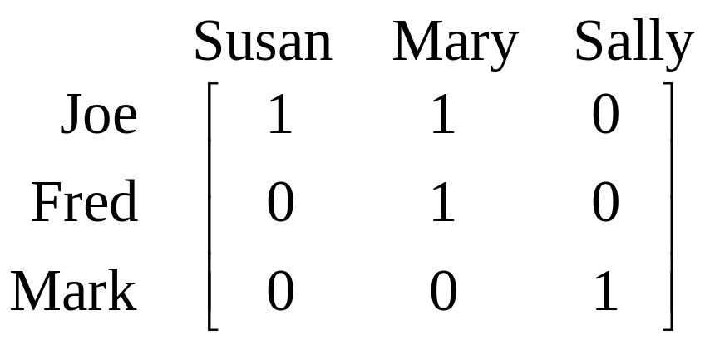
Using Zero-One Matrices
To represent a binary relation R:A×B by an |A|×|B| 0-1 matrix M_{R} = [m_{ij}], let m_{ij} = 1 iff (a_{i},b_{j})∈R.
E.g., Suppose Joe likes Susan and Mary, Fred likes Mary, and Mark likes Sally.
Then the 0-1 matrix
representation
of the relation
Likes:Boys×Girls
relation is:
*
School of Computer Science, BUPT
*

Slide 5
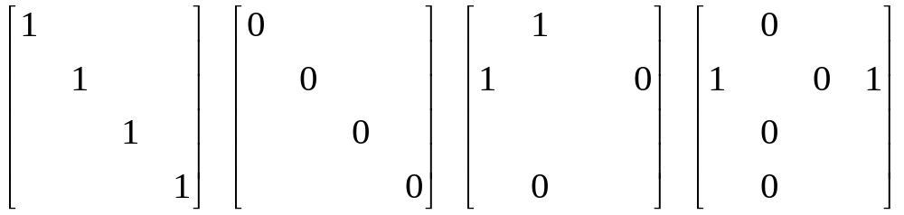
Zero-One Reflexive, Symmetric
Terms: Reflexive, non-reflexive, irreflexive,
symmetric, asymmetric, and antisymmetric.
  These relation characteristics are very easy to recognize by inspection of the zero-one matrix.
any-
thing
any-
thing
anything
anything
any-
thing
any-
thing
Reflexive:
all 1’s on diagonal
Irreflexive:
all 0’s on diagonal
Symmetric:
all identical
across diagonal
Antisymmetric:
all 1’s are across
from 0’s
*
School of Computer Science, BUPT
*

Slide 6
Obvious questions
Given the connection matrix for two relations, how does one find the connection matrix for
  The complement?
  The relative complement?
  The symmetric difference?
*
School of Computer Science, BUPT
*

Slide 7
Combining Connection Matrices
Definition: the join of two matrices M₁, M₂, denoted M₁ ∨ M₂ , is the component wise boolean ‘or’ of the two matrices.
Fact: If M₁ is the connection matrix for R₁ and M₂ is the connection matrix for R₂ then the join of M₁ and M₂, M₁ ∨ M₂ is the connection matrix for R₁ ∪ R₂.
*
School of Computer Science, BUPT
*

Slide 8
Combining Connection Matrices
Definition: the meet of two matrices M₁, M₂, denoted M₁ ∧ M₂ is the component wise boolean ‘and’ of the two matrices.
Fact: If M₁ is the connection matrix for R₁ and M₂ is the connection matrix for R₂ then the meet of M₁ and M₂, M₁ ∧ M₂ is the connection matrix for R₁ ∩ R₂ .
*
School of Computer Science, BUPT
*

Slide 9
Composite of relations
Suppose that R is a relation from A to B and S is a relation from B to C. Suppose that A, B, and C have m, n, and p elements, respectively.
  Let the zero–one matrices for S ◦R, R, and S be M_{S ◦R} = [t_{ij}], M_{R} = [r_{ij}], and M_{S} = [s_{ij}].
  The ordered pair (a_{i}, c_{j}) belongs to S ◦R if and only if there is an element b_{k} such that (a_{i}, b_{k}) belongs to R and (b_{k}, c_{j}) belongs to S.
  It follows that t_{ij} = 1 if and only if r_{ik} = s_{kj} = 1 for some k.
  From the definition of the Boolean product, this means that M_{S ◦R} = M_{R} ⊙M_{S}.
*
School of Computer Science, BUPT
*

Slide 10
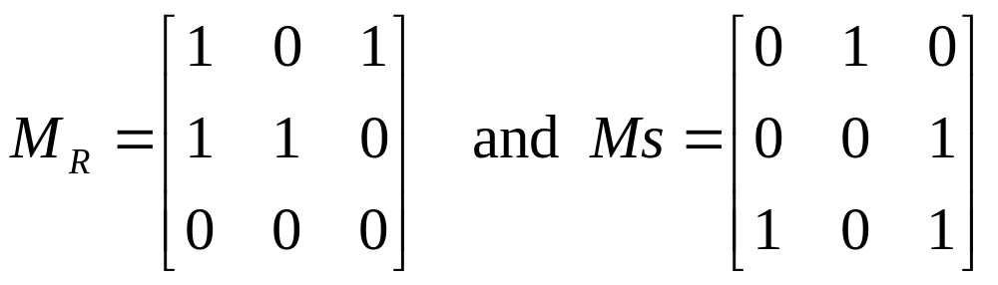
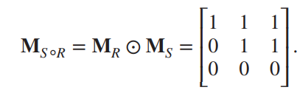
Exmaple 5
Find the matrix representing the relations S ◦R, where the matrices representing R and S are
*
School of Computer Science, BUPT
*

Slide 11
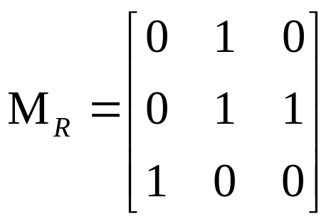
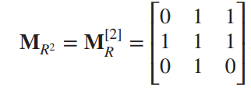
Example 6
  Find the matrix representing the relation R², where the matrices representing R is
*
School of Computer Science, BUPT
*

Slide 12
The Digraph of a Relation
If A is a finite set and R is a relation on A.
  Draw a small circle, called a vertex, for each element of A and label the circle with the corresponding element of A.
  Draw an arrow, called an arc or edge, from vertex a_{i} to vertex a_{j} if and only if a_{i} R a_{j}.
The resulting pictorial representation of R is called a directed graph or digraph of R.
*
School of Computer Science, BUPT
*

Slide 13
Using Directed Graphs
A directed graph or digraph G=(V_{G},E_{G}) is a set V_{G} of vertices (nodes) with a set E_{G}⊆V_{G}×V_{G} of edges (arcs,links). Visually represented using dots for nodes, and arrows for edges. Notice that a relation R:A×B can be represented as a graph G_{R}=(V_{G}=A∪B, E_{G}=R).
Edge set E_{G}
(blue arrows)
Matrix representation M_{R}:
Graph
rep. G_{R}:
Joe
Susan
Fred
Mary
Mark
Sally
Node set V_{G}
(black dots)
*
School of Computer Science, BUPT
*

Slide 14
Example
Let
  A = {1, 2, 3, 4}
  R = {(1, 1), (1, 2), (2, 1), (2, 2), (2, 3), (2, 4), (3, 4), (4, 1)}
Then
2
1
3
4
*
School of Computer Science, BUPT
*

Slide 15
Example
Find the relation determined by
  R = {(1, 1), (1, 3), (2, 3), (3, 2), (3, 3), (4, 3)}
2
1
3
4
*
School of Computer Science, BUPT
*

Slide 16
Definitions
If R is a relation on a set A and a ∈ A, then
  the in-degree of a (relative to the relation R) is the number of b ∈ A such that (b, a) ∈ R.
  the out-degree of a is the number of b ∈ A such that (a, b) ∈ R.
*
School of Computer Science, BUPT
*

Slide 17
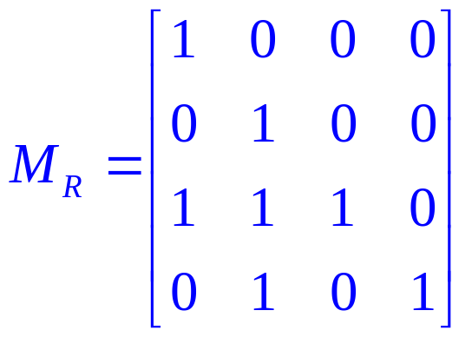
Example
Let A = {a, b, c, d}, and R be the relation on A that has the matrix
  Construct the digraph of R, and list in-degrees and out-degrees of all vertices
*
School of Computer Science, BUPT
*

Slide 18
Solution
b
a
c
d
 | a | b | c | d
in-degree | 2 | 3 | 1 | 1
out-degree | 1 | 1 | 3 | 2
*
School of Computer Science, BUPT
*

Slide 19
Digraph of combined relations
Given the digraphs for R₁ and R₂, find the digraphs for
  R₂ ∪ R₁
  R₂ ∩ R₁
  R₂ − R₁
  R₂ ⊕ R₁
  R₁
*
School of Computer Science, BUPT
*

Slide 20
Example: R from A to B
Let
  A = { a, b, c}
  B = {1, 2, 3, 4}
  R = {(a, 1), (a, 2), (c, 4)}
Then R can be represented by the digraph
1
a
2
b
3
c
4
*
School of Computer Science, BUPT
*

Slide 21
Definition
If R is a relation on a set A, and B is a subset of A, the restriction of R to B is
  R ∩ (B × B)
*
School of Computer Science, BUPT
*

Slide 22
Example
Let
  A = {a, b, c, d, e, f}
  R = {(a, a), (a, c), (b, c), (a, e), (b, e), (c, e)}
  B = {a, b, c}
Then
  B × B = {(a, a), (a, b), (a, c), (b, a), (b, b), (b, c), (c, a), (c, b), (c, c)}
  The restriction of R to B is {(a, a), (a, c), (b, c)}
*
School of Computer Science, BUPT
*

Slide 23
Digraph Reflexive, Symmetric
It is extremely easy to recognize the reflexive/irreflexive/ symmetric/antisymmetric properties by graph inspection.











Reflexive:
Every node
has a self-loop
Irreflexive:
No node
links to itself
Symmetric:
Every link is
bidirectional
Antisymmetric:
No link is
bidirectional
These are non-asymmetric & non-antisymmetric
These are non-reflexive & non-irreflexive
*
School of Computer Science, BUPT
*

Slide 24

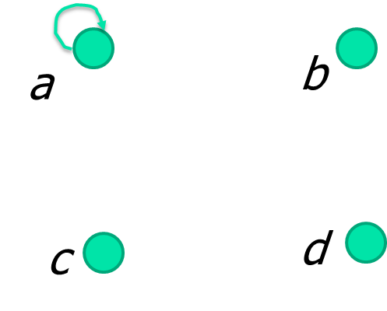
多选题
1分
Determining which Properties a Relation has from its Digraph
A
自反
B
对称
C
反对称
D
非对称
E
传递
提交
*

Slide 25
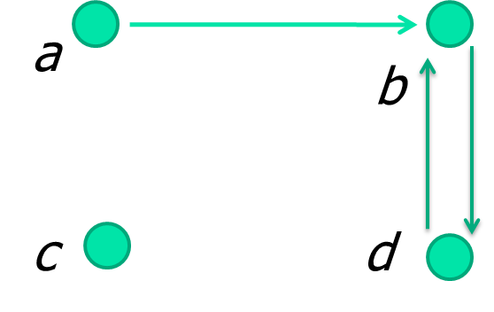
多选题
1分
Determining which Properties a Relation has from its Digraph
A
反自反
B
对称
C
反对称
D
非对称
E
传递
提交
*

Slide 26
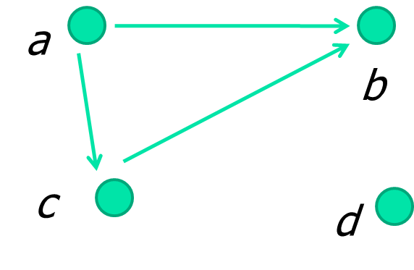
多选题
1分
Determining which Properties a Relation has from its Digraph
A
自反
B
对称
C
反对称
D
非对称
E
传递
提交
*

Slide 27
Example of the Powers of a Relation
b
a
b
a
d
c
d
c
R
R²
a
b
a
b
d
c
d
c
R⁴
R³
The pair (x,y) is in R^{n} if there is a path of length n from x to y in R (following the direction of the arrows).

Slide 28
Ways to …
Identify which properties does a relation R has:
  R
  Digraph of R
  Matrix of R
*
School of Computer Science, BUPT
*

Slide 29
Reflexive or Irreflexive
R is a relation on a set A, Let M_{R} be the matrix of a relation R and Δ be the equality relation, then R is
  Reflexive ⇔ Δ ⊆ R ⇔ all 1's on its main diagonal
  Irreflexive ⇔ Δ ∩ R = ∅ ⇔ all 0's on its main diagonal
*
School of Computer Science, BUPT
*

Slide 30
Symmetric
The matrix M_{R} = [m_{ij}] of a symmetric relation satisfies the property that
  if m_{ij} = l, then m_{ji} = l
  moreover, if m_{ij} = 0, then m_{ji} = 0
  so that M_{R} is a symmetric matrix
*
School of Computer Science, BUPT
*

Slide 31
Asymmetric
The matrix M_{R} = [m_{ij}] of a asymmetric relation satisfies the property that
  if m_{ij} = l, then m_{ji} = 0
  note: m_{ii} = 0
*
School of Computer Science, BUPT
*

Slide 32
Antisymmetric
The matrix M_{R} = [m_{ij}] of a antisymmetric relation satisfies the property that
  if i ≠ j, then m_{ij} = 0 or m_{ji} = 0
*
School of Computer Science, BUPT
*

Slide 33
Transitive
A relation R is transitive if and only if its matrix M_{R} = [m_{ij}] has the property
  if m_{ij} = l and m_{jk} = l, then m_{ik} = l
R² ⊆ R
  if a and c are connected by a path of length 2 in R, then they must be connected by a path of length l.
  if a R² c, then a R c
*
School of Computer Science, BUPT
*

Slide 34
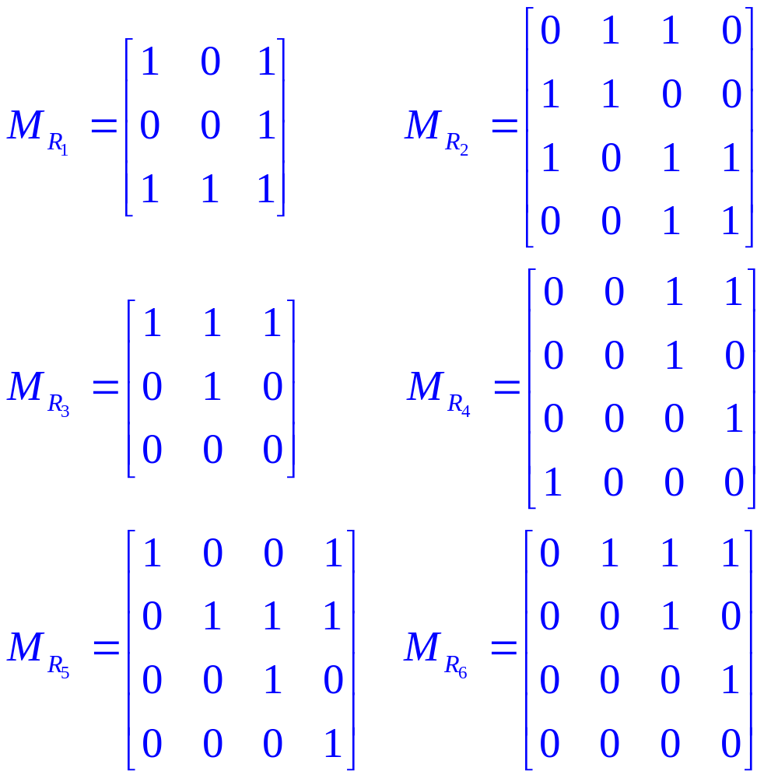
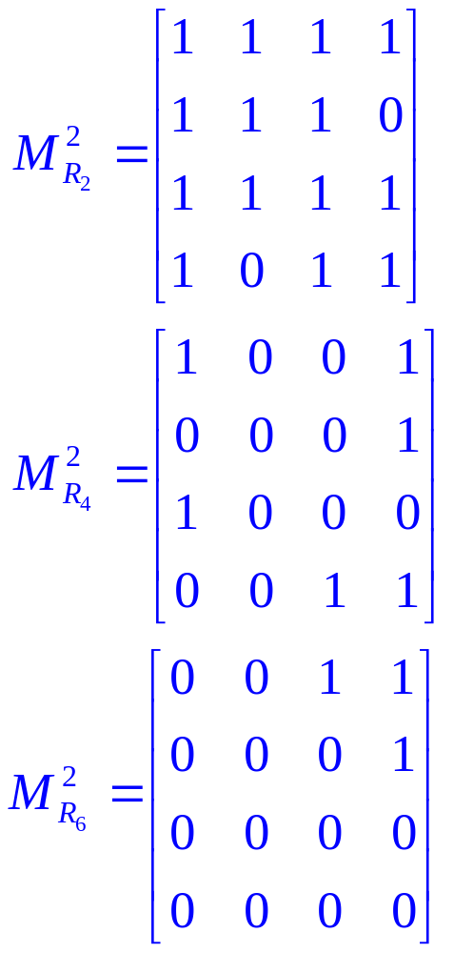
Example
*
School of Computer Science, BUPT
*

Slide 35
Combining Relations
A very large set of potential questions -
Let R₁ and R₂ be binary relations on a set A:
If
  R₁ has property 1
  R₂ has property 2,
does
  R₁ * R₂ have property 3
where * represents an arbitrary binary set operation?
*
School of Computer Science, BUPT
*

Slide 36
Example
If
  R₁ is symmetric,
  and
  R₂ is antisymmetric,
does it follow that
  R₁∪R₂ is transitive?
If so, prove it. Otherwise find a counterexample.
*
School of Computer Science, BUPT
*

Slide 37
Example
Let R₁ and R₂ be transitive on A. Does it follow that
  R₁∪ R₂ is transitive?
Consider
  A = {1, 2}
  R₁ = {(1, 2)}
  R₂ = {(2, 1)}
Then R₁∪ R₂ = {(1, 2), (2,1)} which is not transitive! (Why?)
*
School of Computer Science, BUPT
*

Slide 38
Homework
§9.3
  14, 32
*
School of Computer Science, BUPT
*

